Slide 1
CECS 621-50: Sentiment Detection in Newspaper Headlines
Connor Pigott and Nikhil Paonikar

Slide 2
Data Set
Set of newspaper headlines collected from the Huffington Post and The Onion https://www.kaggle.com/rmisra/news-headlines-dataset-for-sarcasm-detection/home
26,709 total headlines - 14,985 of which were not sarcastic and 11,724 of which were
Attributes included article URL (removed during preprocessing), article headline as a string, and a binary class attribute

Slide 3
Objective
To identify an accurate and reliable model for the purpose of classifying text based on underlying sentiment
To assess the performance of these models based on the amount of training data that is available
Analysis will be performed based on accuracy and precision

Slide 4
Methodology
Analysis will focus on three different, common models for classification
Naïve Bayes
Logistic Regression
Support Vector Machines
All models were applied using the software Weka
Training data would be reduced to 66% and 33% of the total available data to assess model performance with limited inputs

Slide 5
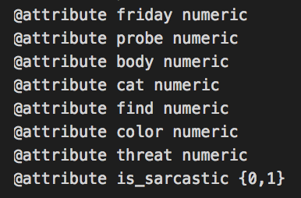
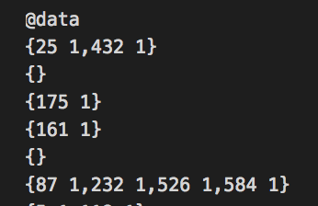
Preprocessing
Convert the raw json data into a usable format for Weka
Eliminating the “URL” variable
Implementing the “String to Word” vector filter and eliminate common words
Rank the words by their indicativeness of a given class and eliminate less indicative words
For subsequent trials with reduced data, preprocessing included removal of equal numbers of sarcastic and not sarcastic headlines
Preprocessed data in ARFF file

Slide 6
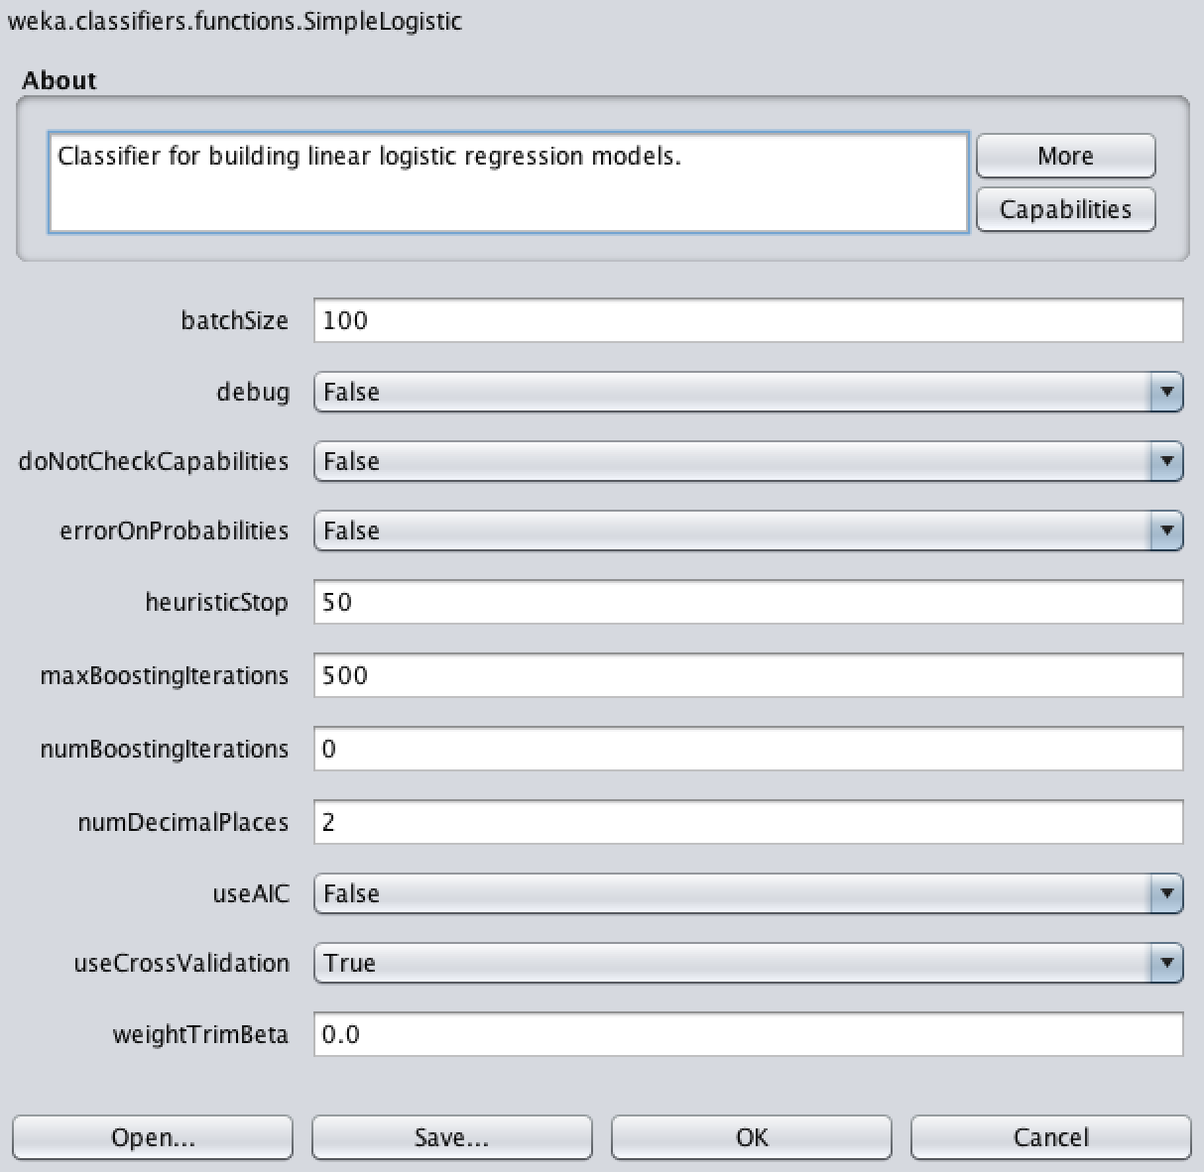
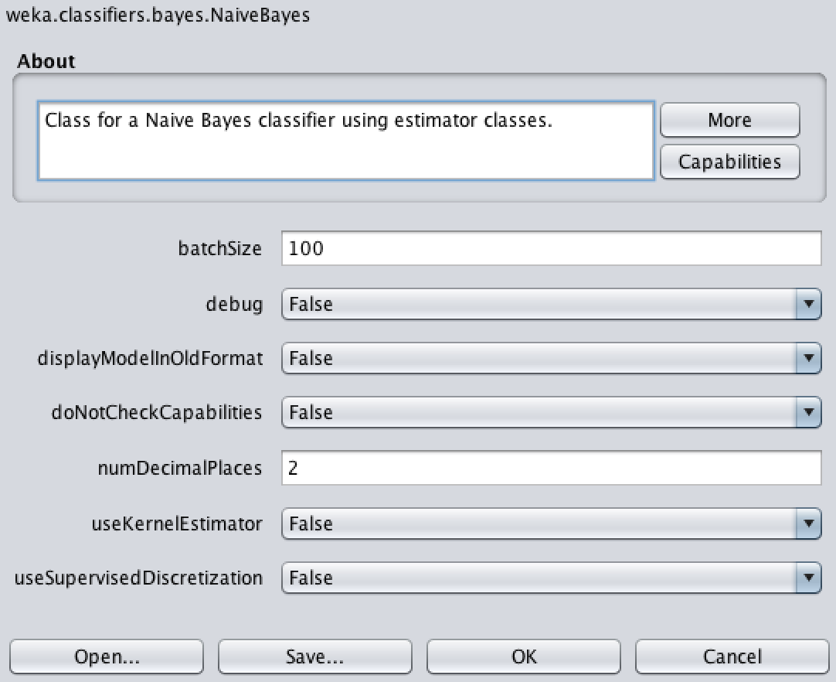
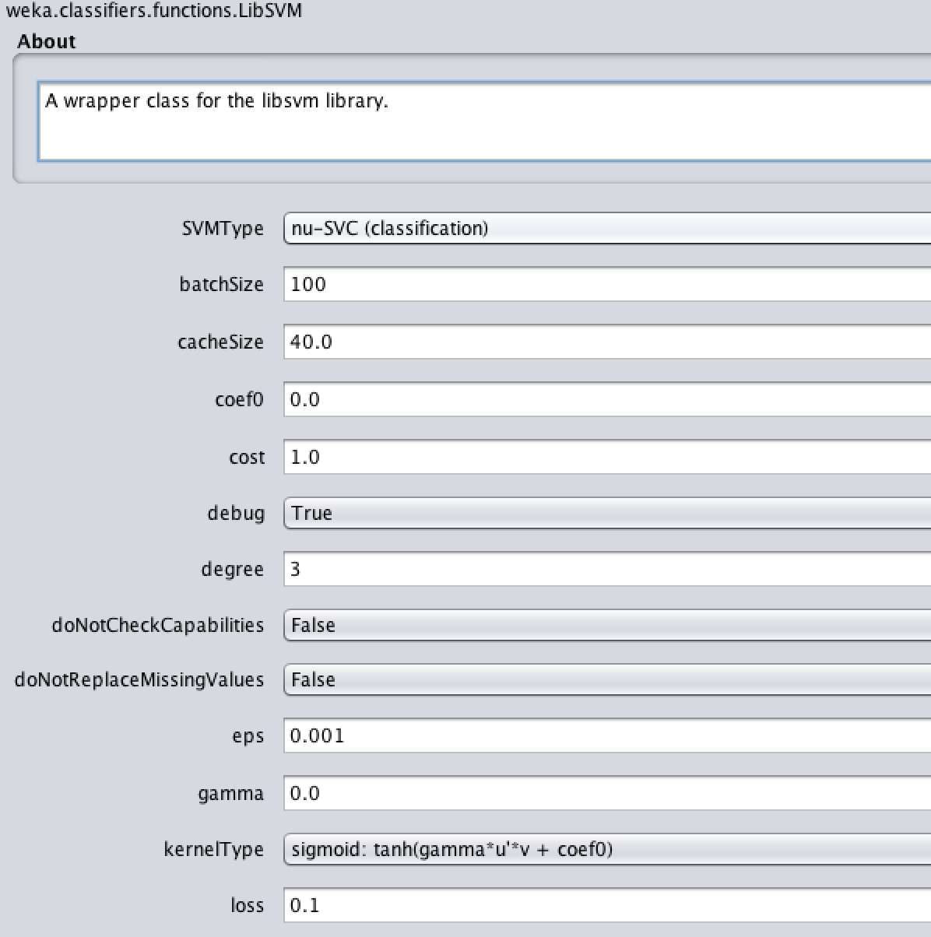
Implementation
Naive Bayes Settings
Support Vector Machines Settings
Logistic Regression Settings

Slide 7
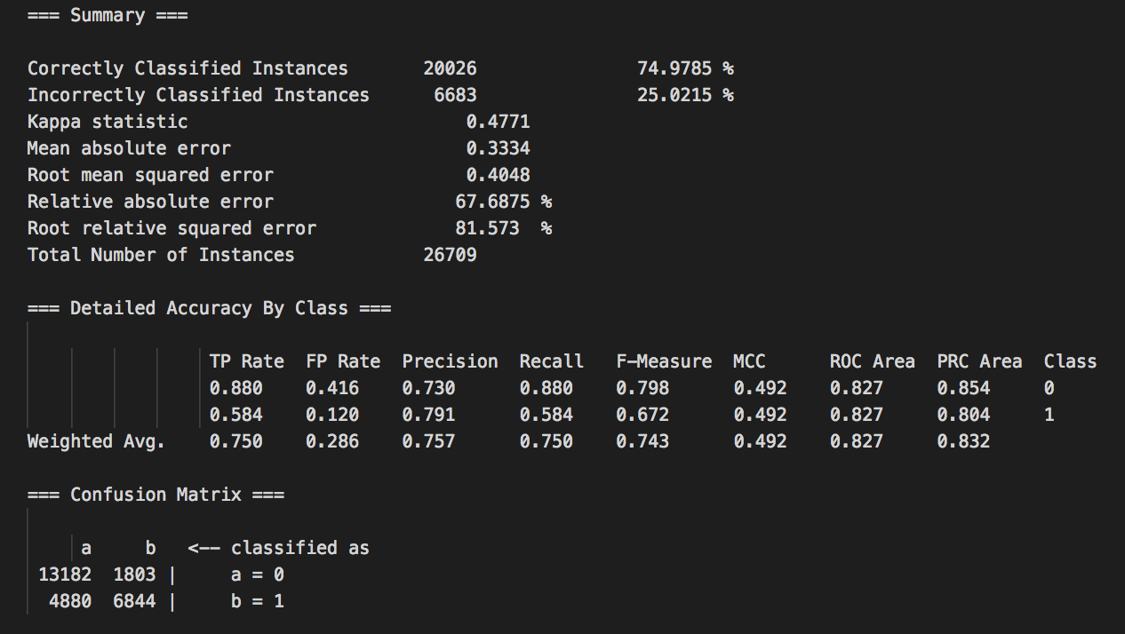
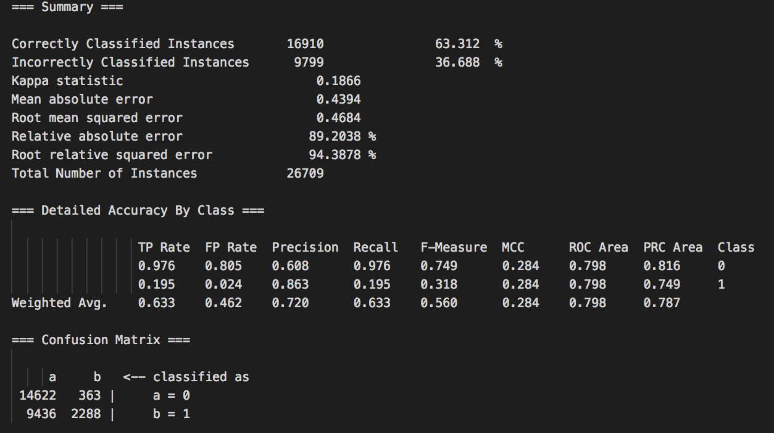
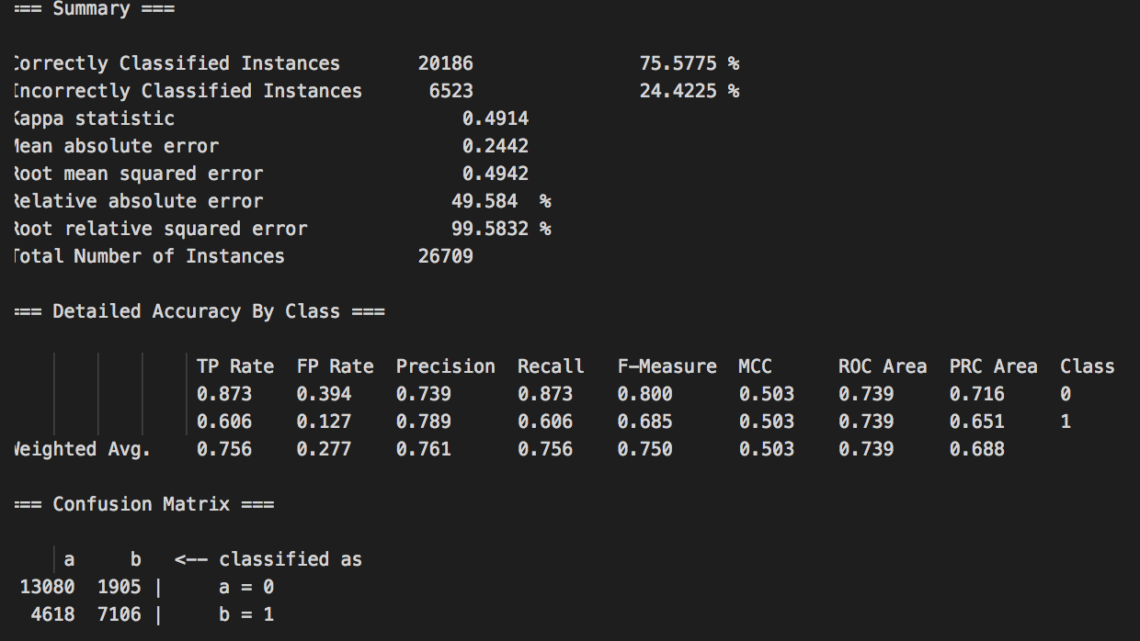
Results - 100% of Data
Logistic Regression Summary
Naive Bayes Summary
Support Vector Machines Results

Slide 8
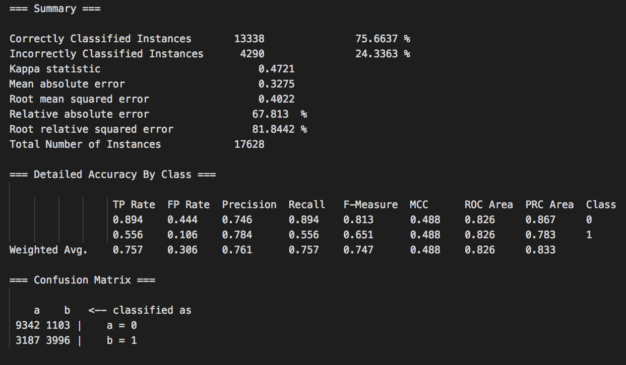

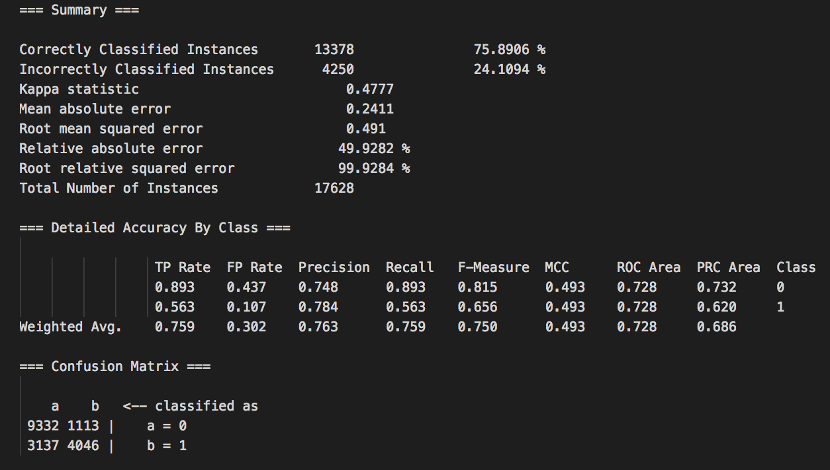
Results - 66% of Data
Logistic Regression Summary
Naive Bayes Summary
Support Vector Machines Results

Slide 9
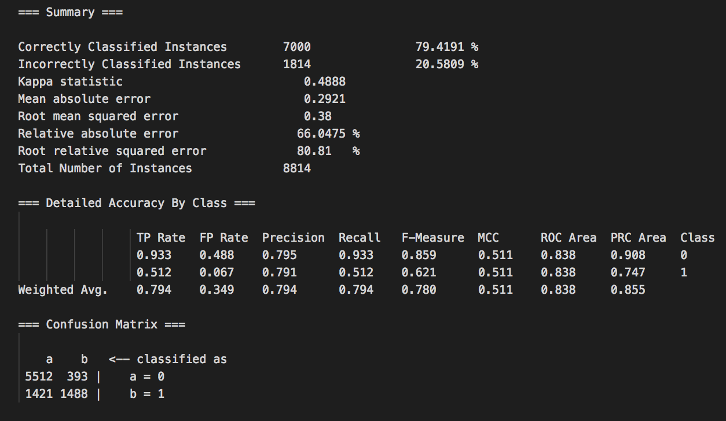
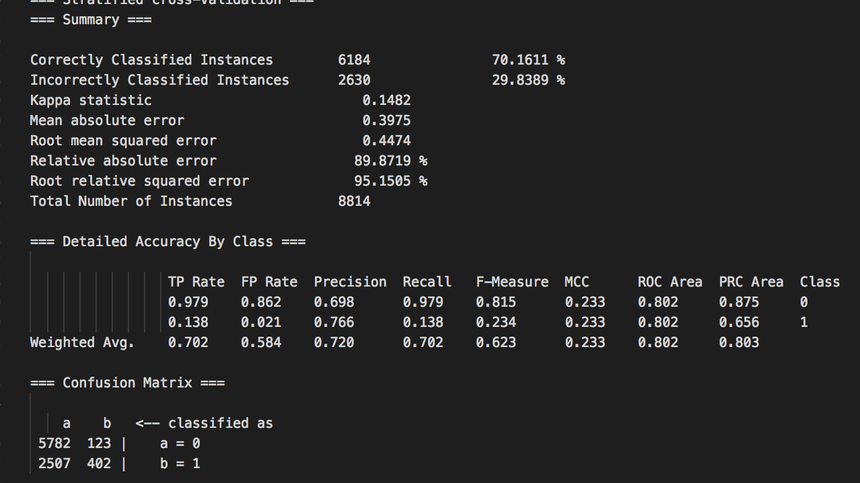
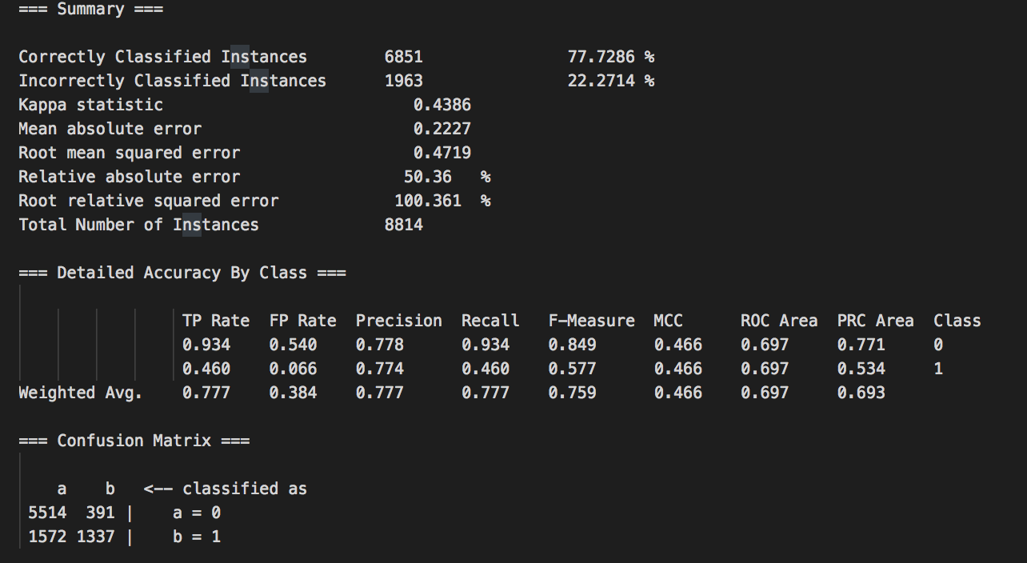
Results - 33% of Data
Logistic Regression Summary
Naive Bayes Summary
Support Vector Machines Results

Slide 10
Summarized Results
Percentage of Data | Naïve Bayes | Logistic Regression | SVM (nu-SVC, sigmoid kernel) | SVM* (C-SVC, linear kernel)
100 | Accuracy: 63.312% Error: 36.688% Area Under ROC: 0.7977 Time Req’d to Build Model: 3.48 seconds | Accuracy: 74.9785% Error: 25.0215% Area Under ROC: 0.8273 Time Req’d to Build Model: 1106.64 seconds | Accuracy: 75.5775% Error: 24.4225% Area Under ROC: 0.7395 Time Req’d to Build Model: 32.98 seconds | Accuracy: 60.5712% Error: 39.4287% Area Under ROC: 0.5532 Time Req’d to Build Model: 61.08 seconds
66 | Accuracy: 64.5564% Error: 35.4435% Area Under ROC: 0.7999 Time Req’d to Build Model: 1.91 seconds | Accuracy: 75.6637% Error: 24.3363% Area Under ROC: 0.8256 Time Req’d to Build Model: 1364 seconds | Accuracy: 75.8906% Error: 24.1094% Area Under ROC: 0.7284 Time Req’d to Build Model: 12.42 seconds | Accuracy: 62.0433% Error: 37.9567% Area Under ROC: 0.5374 Time Req’d to Build Model: 20.4 seconds
33 | Accuracy: 70.1611% Error: 29.8389% Area Under ROC: 0.8020 Time Req’d to Build Model: 0.53 seconds | Accuracy: 79.4191% Error: 20.5809% Area Under ROC: 0.8384 Time Req’d to Build Model: 138.71 seconds | Accuracy: 77.7286% Error: 22.2714% Area Under ROC: 0.6967 Time Req’d to Build Model: 2.63 seconds | Accuracy: 67.2793% Error: 32.7207% Area Under ROC: 0.5043 Time Req’d to Build Model: 4.21 seconds
* Represents preliminary trial of SVM not included in final analysis

Slide 11
Conclusion
Models reasonably accurate but imperfect
Performance: SVM and Logistic Regression > Naive Bayes in these particular instances
Inconclusive performances between SVM and Logistic Regression
Logistic Regression required greatest computing time by an exponential margin
Accuracy, precision increased as training data was reduced
Improvements to this analysis could include:
Using separate training data and classification data
Use data points with more attributes (i.e. longer headlines or something such as tweets or articles)

